Slide 1
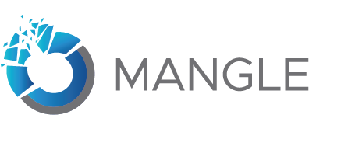
Bringing Chaos (on Purpose) to Your Applications
Avinash Shrimali
Aswathy Ramabhadran
Senior Manager, Chaos Engineering, VMware
Sr Member of Technical Staff, Chaos Engineering, VMware
16th May 2020

Slide 2
What is Mangle?
Orchestrates Chaos
Enables running of chaos engineering experiments seamlessly to assess resiliency and fault tolerance
Single Tool for Applications and Infra
Supports fault injection for applications and infrastructure components
Tried and Tested in VMware
Validated on VMware product and Cloud platforms. Enables running faults against K8S, Docker, vCenter or any Remote Machine with ssh enabled
Container and OVA support - Easily deployed and setup in a matter of minutes using either the container images or OVA package.
Custom fault plugin model - Build and plugin new faults on the fly without building the code from scratch.
Notes:
Orchestrates Chaos - Enables running of chaos engineering experiments seamlessly to assess resiliency and fault tolerance
Single Tool for Applications and Infra - Supports fault injection for applications and infrastructure components
Tried and Tested in VMware - Validated on VMware product and Cloud platforms. Enables running faults against K8S, Docker, vCenter or any Remote Machine with ssh enabled
Container and OVA support - Easily deployed and setup in a matter of minutes using either the container images or OVA package.
Custom fault plugin model - Build and plugin new faults on the fly without building the code from scratch.

Slide 3
Mangle – Supported Faults and Metric Providers
1. Mangle supports four broad category of faults:
Infrastructure Level Faults
Application Level Faults ( JVM based application)
Database Faults
Custom Faults
2. Ability to integrate metric providers
Wavefront
Datadog
Prometheus
Ref: https://vmware-1.gitbook.io/mangle/sre-developers-and-users/injecting-faults

Slide 4
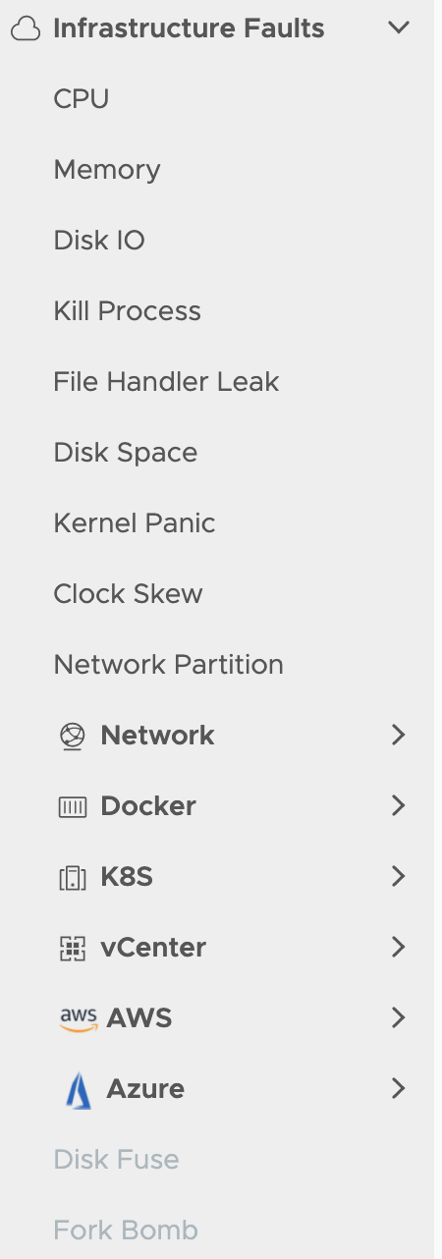
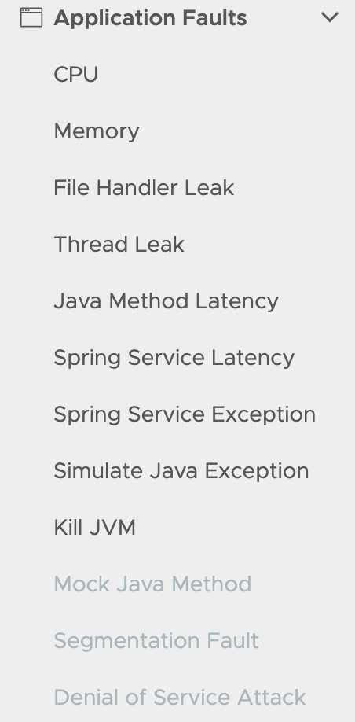
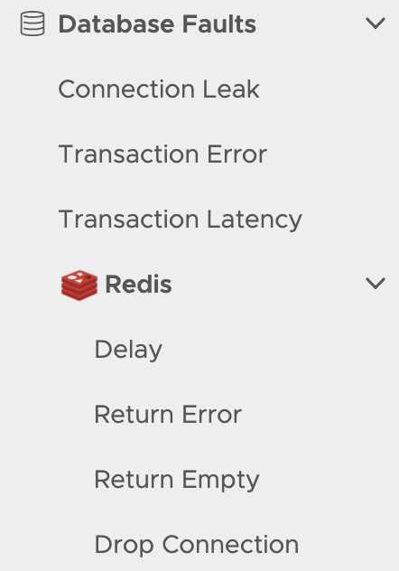

Slide 5
Mangle Value Proposition
Feature | Chaos Monkey | Gremlin | Jepsen | Mangle
REST API Support | r | a | r | a
Simple UI | r | a | r | a
Scheduling of faults | a | a | a | a
Support for Metrics Providers | r | a | r | a
Supported Endpoints | AWS | AWS Remote Machine Docker K8S | Remote Machine | Remote Machine(Single and Cluster of Machines) Docker K8S VCenter AWS Azure Redis Proxy
Support for custom faults | r | r | r | a
Open source | a | r | a | a

Slide 6
DEMO

Slide 7
Mangle Architecture
Cluster Management
Using Hazelcast
Fault Services
Spring Based Rest Services
Common Modules
Spring Scheduler
Micrometer API
Datadog Rest client
Wavefront Rest client
Spring Security
Default Plugin
Pf4j
SSH
Tools like TC, Netem,
Docker rest Client
kubectl
VC Rest API
Customized Byteman
Mangle App Container
Cassandra DB
Spring-Cassandra-data
Datastax tools for Schema Management
Mangle vAPP
Photon OS

Slide 8
Mangle Architecture (Contd…) : Mangle Injection Flow
Mangle REST API Controller / UI
Add endpoint
credentials
Add
endpoint
Endpoint
Test Connection
Explore Requests
and Reports
Monitor Fault Injection
events on configured
Metric Provider
Infra/App level injection
Infra
App(JVM)
Execute
Injection scripts
on
target endpoint
Return: TaskID
Copy Mangle Byteman
Agent
to
target endpoint
Attach agent to
Running JVM application
Invoke Fault in JVM
Return: TaskID
Copy Injection scripts
to
target endpoint

Slide 9
Mangle Admin User Flow
Admin User Login
Add/Update Authentication Providers
Add/Update metric Providers
Configure Mangle Log Levels

Slide 10
Mangle User Flow
User Login
Add Credentials and Endpoint
Trigger/Schedule a Fault
Monitor the Fault Injection Status

Slide 11
Mangle Creating a Custom Fault Flow
Create a plugin file as per template
Upload and load the template file to Mangle
Custom faults become available on the UI
Choose the appropriate plugin id and fault name
Choose the endpoint
Provide the fault parameters
Run the fault
Monitor Status

Slide 12
Mangle Deployment Models
Mangle supports two broad category of deployment models
Single node deployment
Deploy the Mangle Virtual Appliance
Deploy Containers on Docker host
Deploy Pods on Kubernetes cluster
Multi node deployment
Deploying Containers on Docker host
Deploying Pods on Kubernetes cluster
Ref: https://vmware-1.gitbook.io/mangle/mangle-administration/supported-deployment-models

Slide 13

Let thy products be born again like the Phoenix from ashes, glowing in new light!”
Mangle Team
Thank You!
Please email any questions to mangle@vmware.com

